Slide 1
Introduction to TouchDevelop
Lesson 5 – My First App

Slide 2
TouchDevelop My First App
“Dice App”

Slide 3
Learning objectives
To create a game board for a mobile phone app.

Slide 4
My first app
In this lesson, we are going to create an app to simulate the rolling of a dice.

Slide 5
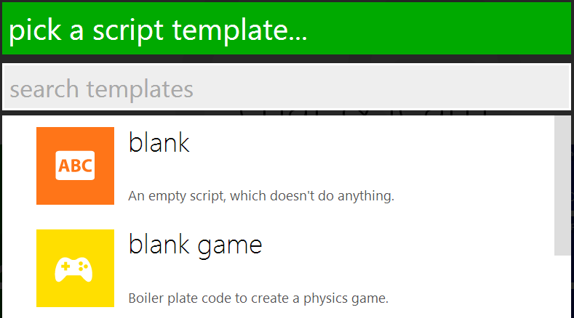
Getting started
Open the TouchDevelop app by visiting http://touchdevelop.com/
Login to your account.
Tap Create Script.
Choose blank.

Slide 6
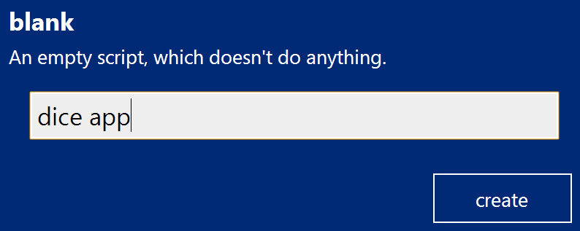
Getting started …
Give your script a name.
Tap on create.

Slide 7
TouchDevelop My First App
“Creating the game board”

Slide 8
Creating the game board
Before we start, we need to create the game board.
In the previous lesson we created a game board for a landscape game (800 pixels by 480 pixels). This time, let’s create a game board for a portrait game (480 pixels by 800 pixels).
Go to ▷ main()
Tap on do nothing.
Tap var on the lower right keyboard.
Rename the variable board.

Slide 9
Creating the game board continued 1...
Tap on media.
Tap on create portrait board.
Next we need to store board in a global variable.
Move the cursor to the new variable.
Tap on promote to data.
Your code should look like this:

Slide 10
Creating the game board continued 2...
Finally, we need to display the game board on the screen. The screen is referred to as the wall so posting board to the wall will display the game board on the screen.
Add a new line.
Tap data.
Tap board.
Tap post to wall.
Your code should look like this:

Slide 11
TouchDevelop My First App
“Adding the dice sprites”

Slide 12
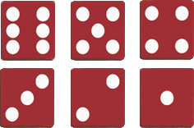
Adding the dice sprites
The next step is to add the images to our script to represent each side of our dice. As explained in previous tutorials, you can either upload a picture of your own or reuse a picture that has already been uploaded by another user.

Slide 13
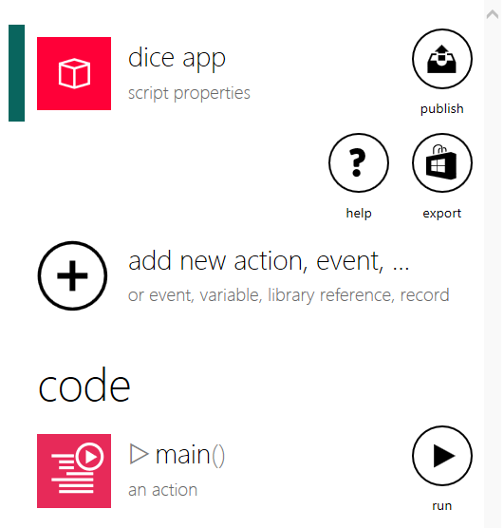
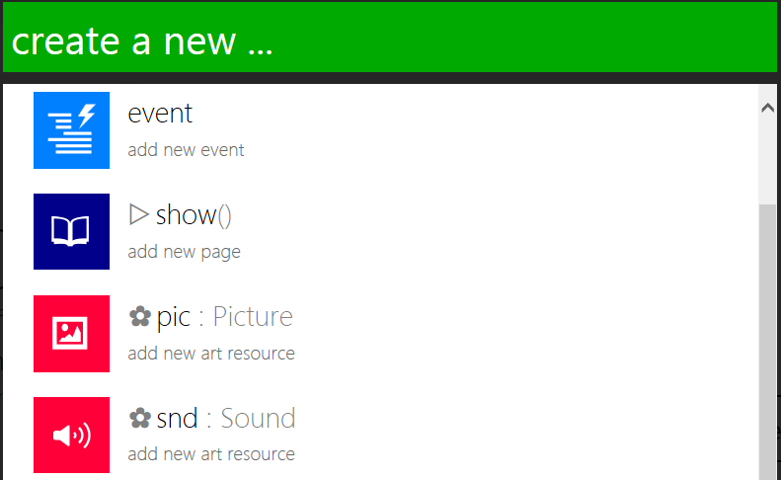
Adding the dice sprites continued 1...
Tap on add new action, event, …
Tap on pic : Picture.

Slide 14
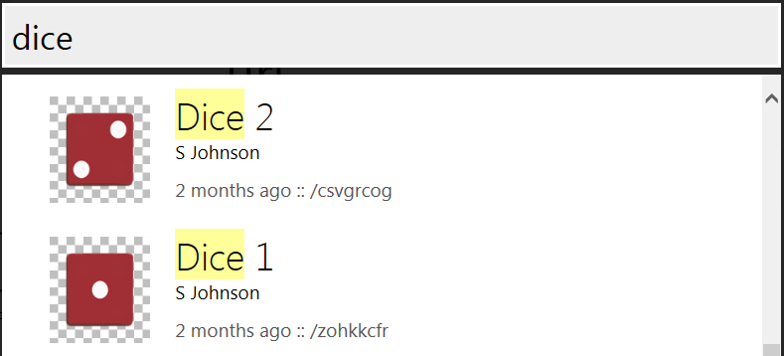
Adding the dice sprites continued 2...
Scroll down and tap on search online art pictures
Type in dice in the search bar.
Find and tap on Dice 1.

Slide 15
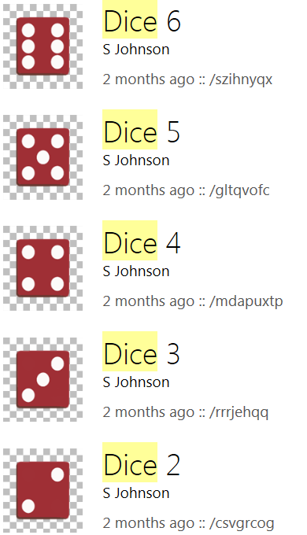
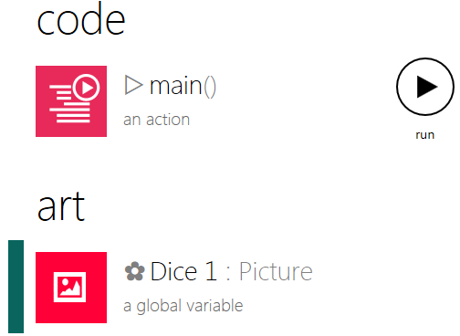
Adding the dice sprites continued 3...
The image will now appear in your art library:
Repeat the above steps for the remaining 5 sides of the dice.

Slide 16
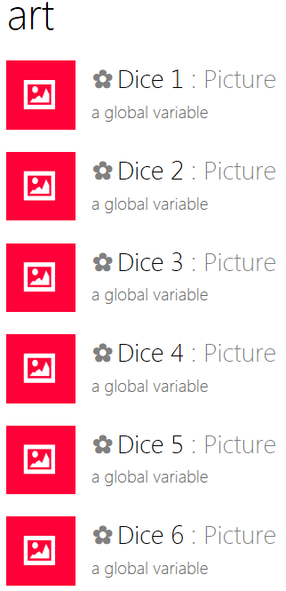
Adding the dice sprites continued 4...
When finished, your art library should look like this:

Slide 17
TouchDevelop My First App
“Rolling the dice”

Slide 18
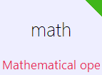
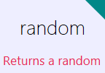
Rolling the dice
First we need to instruct the computer to generate a random number between 1 and 6.
Go to ▷ main()
Add a new line
We will use a variable to store the random number.
Tap var on the lower right keyboard.
Rename the variable dice roll.
Tap on math.
Tap on random
Remember: Click on the blue arrow button to cycle through all the available options.

Slide 19
Rolling the dice continued 1...
Your code should look like this:
Delete the number generated by TouchDevelop and replace it with a 6.
Due to the way in which TouchDevelop works, the code will generate a number between 0 and 5 NOT 1 and 6.
In order to rectify this, we need to add a 1 to the randomly generated number i.e. a 0 will become a 1 and 5 will become 6 etc.

Slide 20
Rolling the dice continued 2...
Tap on the end of the previous line and add + 1 to the end of the code:
Now that we have instructed the computer to generate a random number between 1 and 6, next we will write the code which will display the corresponding image based on the number randomly generated by the computer. For example:
If the computer generates a 1, the code will display dice 1.
If the computer generates a 5, the code will display dice 5.

Slide 21
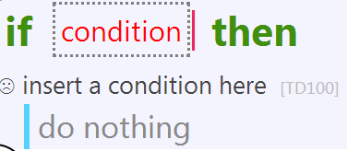
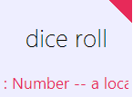
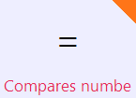
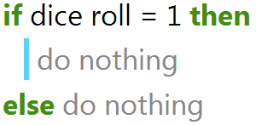
Rolling the dice continued 3...
Add a new line.
Tap on if.
Tap condition.
Tap dice roll.
Tap =
Type in 1.
Your code should look like this:

Slide 22
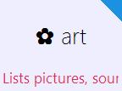
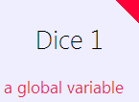
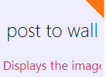
Rolling the dice continued 4...
Tap on do nothing.
In here we will write the code which displays the artwork for dice 1.
Tap on art.
The art button lists all the images we have in our library.
Tap on dice 1.
Now lets display it on the wall.
Tap on post to wall:

Slide 23
Rolling the dice continued 5...
Now lets add the code for dice 2. We will add the next if statement directly after the else statement.
Tap do nothing after the else statement.
Tap on if.
Tap condition.
Tap dice roll.
Tap =
Type in 2.

Slide 24
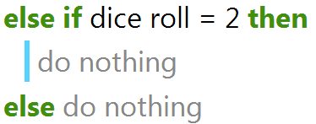
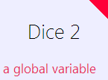
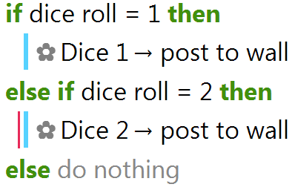
Rolling the dice continued 6...
Tap on do nothing.
In here we will write the code which displays the artwork for dice 2.
Tap on art.
Tap on dice 2.
Tap on post to wall:
Your code should look like this:

Slide 25
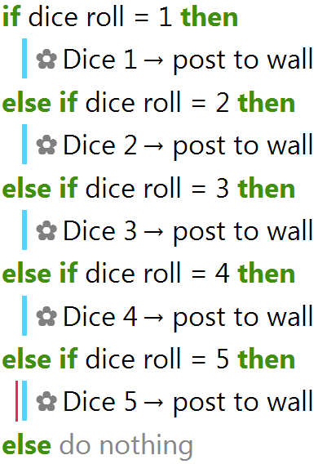
Rolling the dice continued 7...
Repeat the above steps for dice 3 to 5. Your finished code should look like this:
Finally, we will write the code which displays the artwork for dice 6.

Slide 26
Rolling the dice continued 8...
As this is the last possible number we do not need to write another if statement. Instead, we will add the code for dice 6 directly after the last else statement.
Tap on do nothing after the last else statement.
Tap on art.
Tap on dice 2.
Tap on post to wall.

Slide 27
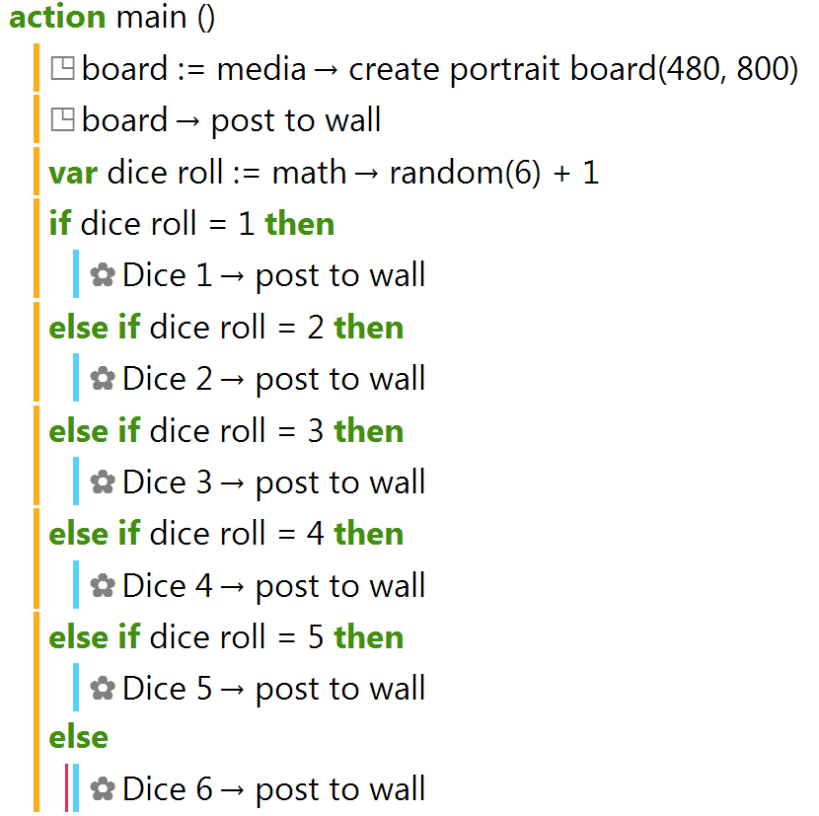
Rolling the dice continued 9...
Your finished script should look like this:
Run your script to see what happens.

Slide 28
TouchDevelop My First App
Challenge

Slide 29
Challenge
Challenge 1: Add a second dice to your game and edit the script so that it adds the total of the two dice and displays the total on the screen.
Challenge 2: Using the dice game as an example, create a coin toss game that will randomly pick heads or tails.
Challenge 3: Using the dice game as an example, create a random name selector which will randomly pick a student from your class.
Collaborate: Share your game with your classmates and see if they can improve your code.

