Slide 1
Representation of Data
Binary Representation of Instructions

Slide 2
Learning Objectives
Explain how instructions are coded as bit patterns
Explain how the computer distinguishes between instructions and data

Slide 3
Instructions
Computer programs are made up of instructions. So far you have been writing programs using high level programming languages such as Python however, when you compile and run your programs, the computer must convert the high level code into a binary representation of the instruction (machine code). This is done using a compiler or interpreter.

Slide 4
Instructions
Each instruction is made up of two parts:
Opcode (Instruction)
Operand (data or address)
There are several different instructions that a CPU can understand. The name given to these series of instructions is the instruction set.

Slide 5
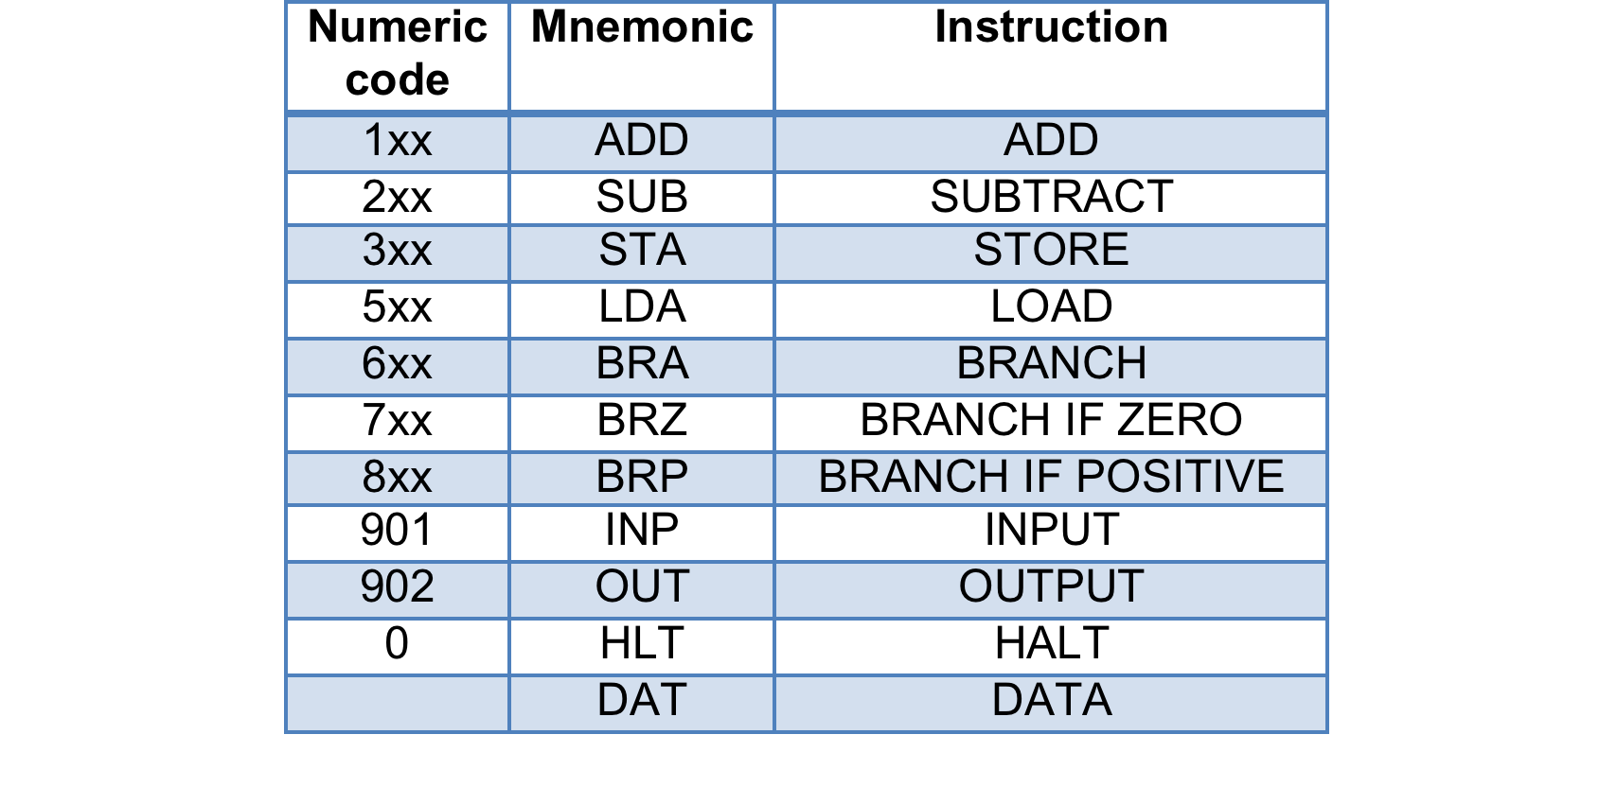
Little Man Computer
Instruction set for Little Man Computer

Slide 6
Instruction Set
The range of instructions that a CPU can understand is based on the number of bits that are used to store the instructions. Some processors (Intel, AMD) use bigger bits to store the instruction set meaning they can have more instructions whereas other processors such as ARM processors (found in the Raspberry Pi) use smaller bits for the instruction (Opcode), meaning less instructions but leaving more space for the data / memory address (Operand).

Slide 7
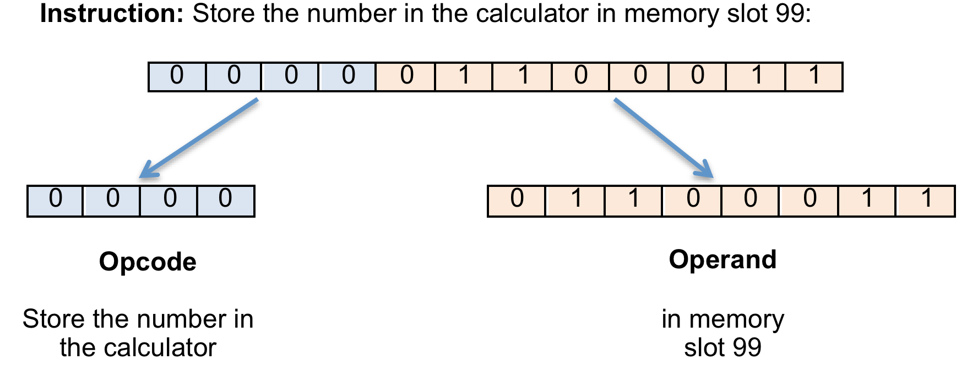
Binary Representation of Instructions
There is no set binary pattern for different opcodes - different processors will use different bit patterns. Assuming that the CPU uses 4-bits to store the instruction (Opcode) and 8-bits to store the data, this what an instruction might look like in machine code:

Slide 8
Task
Create a revision podcast on how instructions are represented using binary.
Note: You do not need to memorise the codes! You just need to understand how they are stored in binary.

