Slide 1
Introduction to TouchDevelop
Lesson 2 – My First Script

Slide 2
TouchDevelop My First Script
action main()
“Hello World” → post to wall
“Hello World”

Slide 3
Learning objectives
To know how to handle text in TouchDevelop.
To understand the role of variables.
To understand the need for loops.
To create a loop in TouchDevelop.

Slide 4
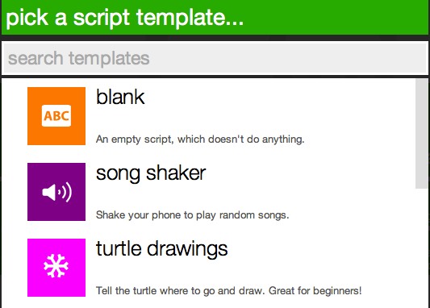
Getting started
Open the TouchDevelop app by visiting http://touchdevelop.com/
Login to your account.
Tap Create Script.
Choose blank.

Slide 5
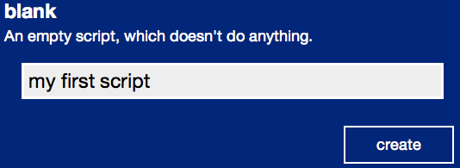
Getting started ….
Give your script a name.
Tap on create.

Slide 6
Hello World
Go to ▷ main()
Tap on do nothing
Tap on the “abc” button in the lower left keyboard.
Type Hello World.

Slide 7
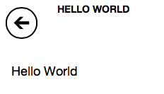
Hello World continued…
Tap on the post to wall button from the lower right keyboard.
Your code should look like this:
Tap the run button to see what the code does.
Congratulations! You have written your first TouchDevelop program.

Slide 8
TouchDevelop My First Script
User Input

Slide 9
User Input
Now let's try something a little more interactive!
Go to ▷main()
Delete all the code by selecting each line and tapping cut
Add a new line

Slide 10
User Input continued 1…
Name
Now let's add an input box to allow the user to enter their name!
First we need to create a variable to store the name that the user enters. A variable is like a box which can be used to store information.
In TouchDevelop, a variable is assigned using the var command.
Tap on var in the blue section of the lower right keyboard.
Variable

Slide 11
User Input continued 2…
By default, TouchDevelop will automatically assign a name for each new variable (see below).
Let's give the variable a more meaningful name.
Tap on x and type in username.

Slide 12
User Input continued 3…
Now we need to create an input box for the user to enter their name.
Tap on wall in the lower right keyboard.
Tap on ask string.
If you can’t see the ask string button, click on the blue arrow button to cycle through all the available options.
Your code should look like this:

Slide 13
User Input continued 4…
Finally, we need to give the user an instruction e.g. “What is your name?” or “Please enter your name in the box?” etc.
Tap edit on the lower right keyboard.
Type in an instruction for the user e.g. What is your name?.
Your code should now look like this:

Slide 14
Adding a reply
Now let's program the computer to reply with a personalised greeting.
First we need to create a variable to store the personalised greeting.
Add a new line.
Tap on var in the blue section of the lower right keyboard.
Rename the variable to greeting.

Slide 15
Adding a reply continued 1…
Tap on the “abc” button in the lower left keyboard.
Type Hello. Hint: Make sure you leave a space at the end of Hello!
We are now going to add the name the user has entered to the end of the greeting. To do this we use the concatenation command.
Tap on II from the lower right keyboard.
Tap on username from the lower right keyboard.

Slide 16
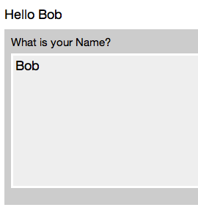
Adding a reply continued 2…
Your code should look like this:
Finally, let's print the personalised greeting.
Add a new line.
Tap on greeting from the lower right keyboard.
Tap on post to wall.
Tap the run button to see what the code does.

Slide 17
TouchDevelop My First Script
?
Guess My Number

Slide 18
Guess My Number
You are going to create a Guessing Game where the Computer generates a random number between 1 and 100 and then responds to your input with one of the following:
Higher
Lower
Well done!
If the correct answer is guessed then the program ends.

Slide 19
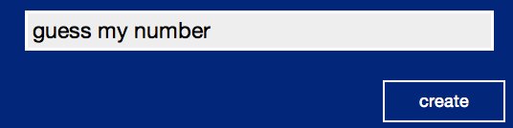
Guess my number continued 1…
Go back to http://touchdevelop.com/
Tap Create Script.
Choose blank.
Name your script Guess my number.
Tap on create.

Slide 20
Guess my number continued 2…
First we need to create a variable to store the random number.
Go to ▷ main()
Tap on do nothing
Tap on var in the lower left keyboard.
Rename the new variable random number.
Next we need to generate a random number. We do this using the math command.
Tap on math in the lower left keyboard.

Slide 21
Guess my number continued 3…
Let's generate a number between 1 and 100.
Tap random on the lower right keyboard.
Type in 100. Your code should look like this:
Due to the way in which TouchDevelop works, the code will generate a number between 0 and 99 NOT 1 and 100.
In order to rectify this, we need to add a 1 to the randomly generated number i.e. a 0 will become a 1 and 99 will become 100 etc.

Slide 22
Guess my number continued 4…
Tap on the first line and add + 1 to the end of the code:
Next we need to set a flag to let the computer know when the user has guessed the number right. (This will become useful later on!). We will use a variable to store the flag.
Add a new line.
Tap on var in the lower right keyboard.
Rename the variable guessed right.
Tap on false in the lower left keyboard.

Slide 23
Guess my number continued 5…
Next we need to ask the user to enter their guess.
Add a new line.
Tap on var in the lower right keyboard.
Rename the variable guess.
Now we need to create an input box for the user to enter their number.
Tap on wall in the lower right keyboard.

Slide 24
Guess my number continued 6…
In the hello world example, we used the ask string command to create an input box however, because this time we want the user to enter a number rather than text, we instead use the ask number command.
Tap on ask number on the lower right keyboard.
Remember: If you can’t see the ask string button, click on the button.
Tap on “abc” in the lower left keyboard.
Type in What’s my number.

Slide 25
Guess my number continued 7…
Next we need to program the computer to respond to the users guess.
Guess is higher – “Lower”
Guess is lower – “Higher”
Guess is correct – “Congratulations!”
For this we use the if command.

Slide 26
Guess my number continued 8…
First let's create a response if the users guess is lower (less than) the number chosen randomly by the computer.
Add a new line.
Tap on if in the lower right keyboard.
Tap on guess on the lower right keyboard. (The variable used to store the users guess.)
Tap on < (less than symbol) in lower right keyboard.
Tap on random number in the lower right keyboard. (The variable used to store number chosen randomly by the computer.)

Slide 27
Guess my number continued 9…
Your code should look like this:
Tap on do nothing (in-between the if and else commands.)
Tap on “abc” in the lower left keyboard.
Type “Higher”
Tap on post to wall in the lower right keyboard.

Slide 28
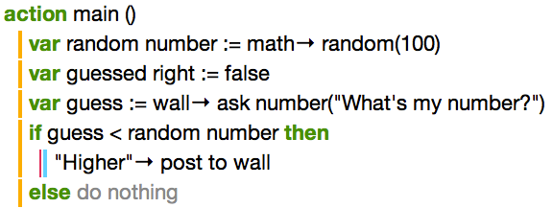
Guess my number continued 10…
Your code should look like this:

Slide 29
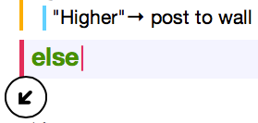
Guess my number continued 11…
Next we need to generate a response for if the users guess is higher (greater) than the random number. For this we are going to use an else if command.
Tap on else.
Tap on if on the lower right keyboard.
Tap on guess on the lower right keyboard. (The variable used to store the users guess.)
Tap on > (greater than symbol) in lower right keyboard.
Tap on random number in the lower right keyboard. (The variable used to store number chosen randomly by the computer.)

Slide 30
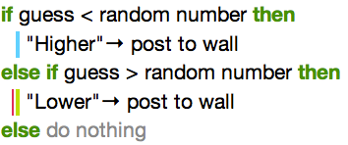
Guess my number continued 12…
Tap on do nothing (in-between the else if and else commands.)
Tap on “abc” in the lower left keyboard.
Type “Lower”
Tap on post to wall in the lower right keyboard.
Your code should look like this:

Slide 31
Guess my number continued 13…
We now need to generate a response for when the user guesses right.
Tap on else.
Tap on “abc” in the lower left keyboard.
Type “Congratulations!”
Tap on post to wall in the lower right keyboard.

Slide 32
Guess my number continued 14…
Finally, we need to tell the computer that the user has guessed right (the reason for this will become clearer in a moment).
Tap on the last line of code and add a new line.
Remember the variable we set at the beginning of this exercise (“guessed right”). We are now going to set this to true.
Tap on guessed right in the lower right keyboard.
Tap on := in the lower right keyboard.
Tap on true in the lower left keyboard.

Slide 33
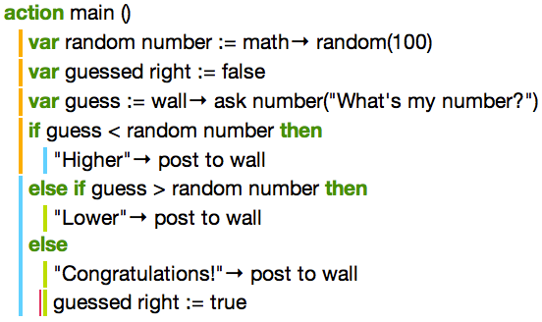
Guess my number continued 15…
Your code should look like this:
Tap the run button to see what the code does.
Q. What is the problem with this code?

Slide 34
Guess my number continued 16…
Did you spot the problem with this code? The user is only allowed one guess. (Not much fun is it!) Let's improve the code with a “Loop”.
Remember in lesson 1 (Fun with loops) we used a loop to save us from typing the same code lots of times. We are going to use a loop again but this time we are going to use a new loop called a “While Loop”.
While loops are used when we don’t know exactly how many times we need to repeat a loop or if we want to repeat a section of code until a certain condition is met.
In this example, we want to loop the code until the user guesses right.

Slide 35
Guess my number continued 17…
First we need to select the code we wish to repeat.
Tap on the line beginning: “var guess :=“
Tap on the select button.
Your screen should look like this:
Tap on the bottom red handle and drag it down so that it highlights the rest of the code.

Slide 36
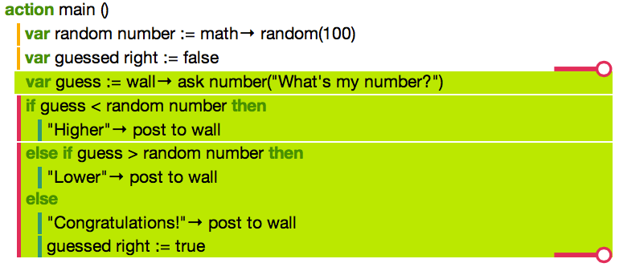
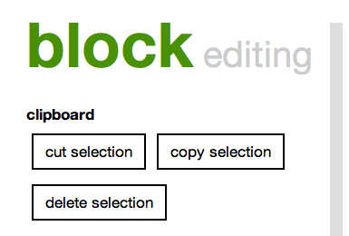
Guess my number continued 18…
Your screen should look like this:
You should also have a new window appear on the left hand side of your screen. (The block editing window.)

Slide 37
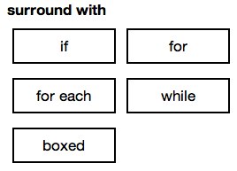
Guess my number continued 18…
Scroll down the block editing window until you come across a section called surround with
Tap on while.
Remember the variable we set at the beginning of this exercise (“guessed right”). We are going to repeat the code while guessed right is false.
Tap on guessed right in the lower right keyboard.

Slide 38
Guess my number continued 19…
Tap on equals in the lower left keyboard.
Notice: TouchDevelop will analyse your code and automatically put in what it thinks is the correct code. You can easily change the code if you need to however, in this case, we don’t need change anything. Your code should look like this:
Tap the run button to see what the code does.

Slide 39
TouchDevelop My First Script
Challenge

Slide 40
Challenge
Challenge 1: Modify your guessing game so that the user has only 8 attempts. Hint: Remember lesson 1 – fun with loops.
Challenge 2: Ask the user to enter their name at the start of the game and create a personalised message when the user guesses the number right.
Collaborate: Share your game with your classmates and see if they can improve your code.

