Slide 1
Simon Johnson CAS Master Teacher Microsoft Innovative Expert Educator Raspberry Pi Cert. Educator
B: teachwithict.weebly.com
T: @clcsimon
E: sjohnson@hswv.org.uk

Slide 2
From Blocks to Code #CASWolves
An Introduction to Programming
On behalf of Computing At School

Slide 3
What is an Algorithm?
Definition:
Sequence of instructions to make something happen.

Slide 4
Magic & Computer Science
What do card tricks have to do with Computer Science?

Slide 5
Computational Thinking?
Decomposition
Pattern Recognition
Abstraction
Algorithm Design

Slide 6
Why teach Computational Thinking?
“Computational thinking is a fundamental skill for everyone, not just for computer scientists. To reading, writing and arithmetic, we should add computational thinking to every child’s analytical ability.” – Jeannette M. Wing

Slide 7
Think Like a Computer
Sandwich Bot

Slide 8
Think Like a Computer: Sandwich Bot
In this exercise, students are asked to create an algorithm from set commands to program their teacher (sandwich bot) to make a jam sandwich.

Slide 9
Making a Cup of Tea…

Slide 10
From Blocks to Code
BYOB (Build Your Own Blogs) Programming

Slide 11
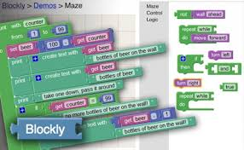
BYOB Languages
Blockly
Scratch
Kodu
Daisy the Dinosaur (iOS/Android)

Slide 12
From Blocks to Code
Higher Level Languages

Slide 13
Higher Level Languages
Python
touchdevelop
Minecraft Pi / Edu
Sonic Pi

Slide 14
Simon Johnson Microsoft Innovative Expert Educator CAS Master Teacher
Contact
B: teachwithict.weebly.com
T: @clcsimon
E: sjohnson@hswv.org.uk

