Slide 1
Introduction to TouchDevelop
8
Lesson 3 – Comments & Lists

Slide 2
Learning objectives
Understand the purpose of a list
Create and call a list
Understand the purpose of comments in code

Slide 3
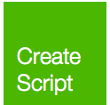
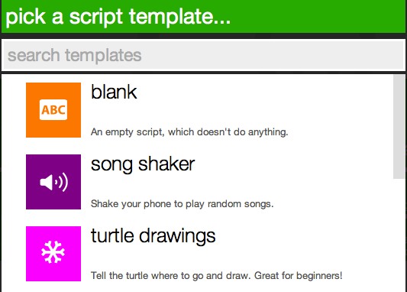
Getting started
Open the TouchDevelop app by visiting http://touchdevelop.com/
Login to your account
Tap “Create Script”
Choose “blank”

Slide 4
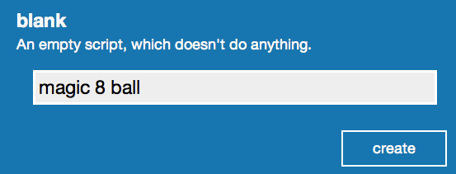
Getting started ….
Give your script a name
Click on “create”

Slide 5
Comments
Comments are bits of text to explain what different bits of code do.
Comments are VERY important in coding.
Comments make it easier for someone else looking at your code to understand. Comments also act as a reminder when looking back at your code.
In TouchDevelop, comments are added using the Insert Comment command

Slide 6
Comments
Go to ▷ main()
Tap on do nothing
Let’s add our first comment to explain our first line of code:
Tap on the “Insert Comments” button in the lower left keypad.
Tip: If you can’t see the Insert comment button, click on the blue arrow button to cycle through all the available options.

Slide 7
Comments continued …
Type in “This next line sets the background picture”

Slide 8
Setting the background
Let’s use an image of a Magic 8 Ball for our background.
Go to ▷main()
Add a new line
Tap on wall in the lower right keyboard
Tap on set background picture
If you can’t see the set background button, click on the blue arrow button

Slide 9
Setting the background continued…
Tap on art
Let's use a picture a user has already loaded.
Tap on the search bar and type in magic8
After a couple seconds, you should see various images of 8 balls on the left pane. Tap the picture you want to use, it will automatically be added as an art resource to your game.
Your code should look like this:

Slide 10
Collections (Lists)
Most programming languages have some way of creating a collection of items, usually this takes the form of an Array or Linked List.
In TouchDevelop, a collection of items is simply referred to as a collection! A collection can contain a variety of things e.g. text, numbers, images etc.
In this exercise you are going to create a string collection to store your magic 8 ball responses.

Slide 11
Collections continued …
Add a new line
Tap on collections
Tap on create string collection
Next we need to store our collection in a variable

Slide 12
Collections continued 2…
Tap on store in var in the lower right keyboard.
By default, TouchDevelop will automatically assign a name for each new variable (see below).
Let's give the variable a more meaningful name.
Tap on rename
Type in response

Slide 13
Collections continued 2…
Next we need to add our responses to our collection.
Add a new line
Tap on response
Let’s add our first response
Tap on add
Tap on edit
Type in it is certain

Slide 14
Collections continued 3…
Repeat the previous step for each of the following responses:
Without a doubt
Most likely
Outlook good
Ask again later
Cannot predict now
Don't count on it
My sources say no

Slide 15
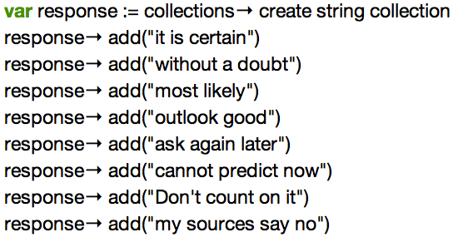
Collections continued 4…
Your code should look like this:

Slide 16
User Input
Next, we need to instruct the user to type in a yes / no question.
Tap on wall in the lower right keyboard.
Tap on ask string.
If you can’t see the ask string button, click on the blue arrow button Your code
Tap edit on the lower right keyboard
Type in an instruction for the user e.g. Please type in a yes / no question
Tap on store in var

Slide 17
Displaying a response
Next let’s add a random response from our collection. To do this, we use the random command.
Add a new line
Tap on response
Tap on random
Tap on store in var
Tap on rename
Type in result

Slide 18
Displaying a response continued …
Your code should look like this:
Finally, let’s display our response on the screen
Add a new line
Tap on result
Tap on post to wall
Run your game to see what happens

Slide 19
TouchDevelop Challenge
8
Magic 8 Ball Challenge

Slide 20
Challenge 1
Below is a complete set of responses for the Magic 8 Ball game. Add the remaining responses to your collection to complete the game:
It is certain
It is decidedly so
Without a doubt
Yes definitely
You may rely on it
As I see it, yes
Most likely
Outlook good
Yes
Signs point to yes
Reply hazy try again
Ask again later
Better not tell you now
Cannot predict now
Concentrate and ask again
Don't count on it
My reply is no
My sources say no
Outlook not so good
Very doubtful

Slide 21
Challenge 2
Go through your code and add more comments

